Slide 1
Where to find the data team?
Jeff Leek
@jtleek
www.jtleek.com

Slide 2
General purpose
LinkedIn
monster.com

Slide 3
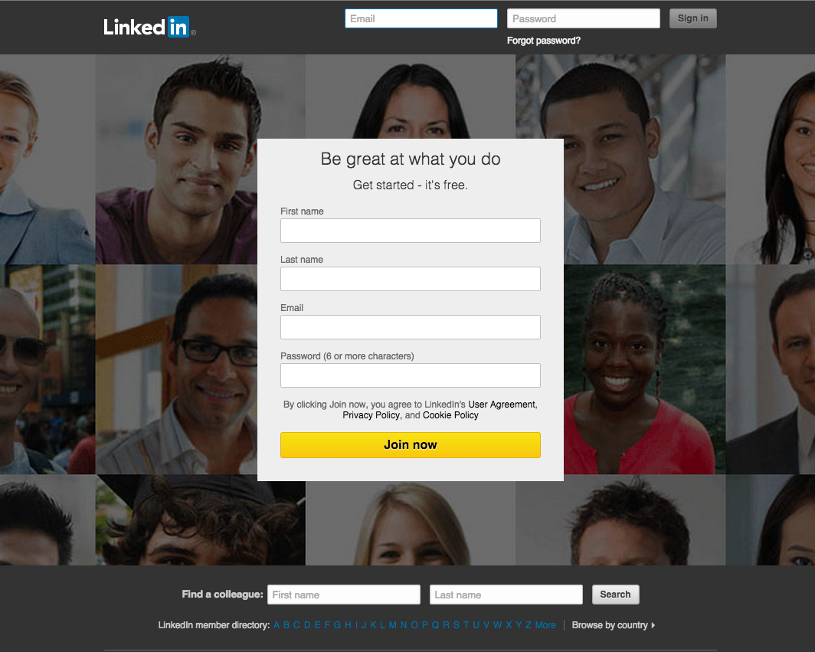
https://www.linkedin.com/

Slide 4
Dedicated
Kaggle
Insight
Hired

Slide 5
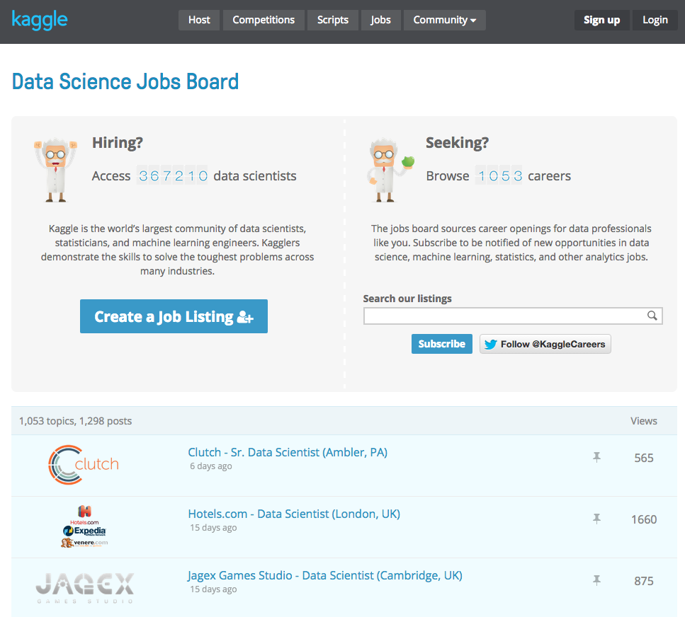
www.kaggle.com/jobs

Slide 6
Online
Coursera
Udacity

Slide 7
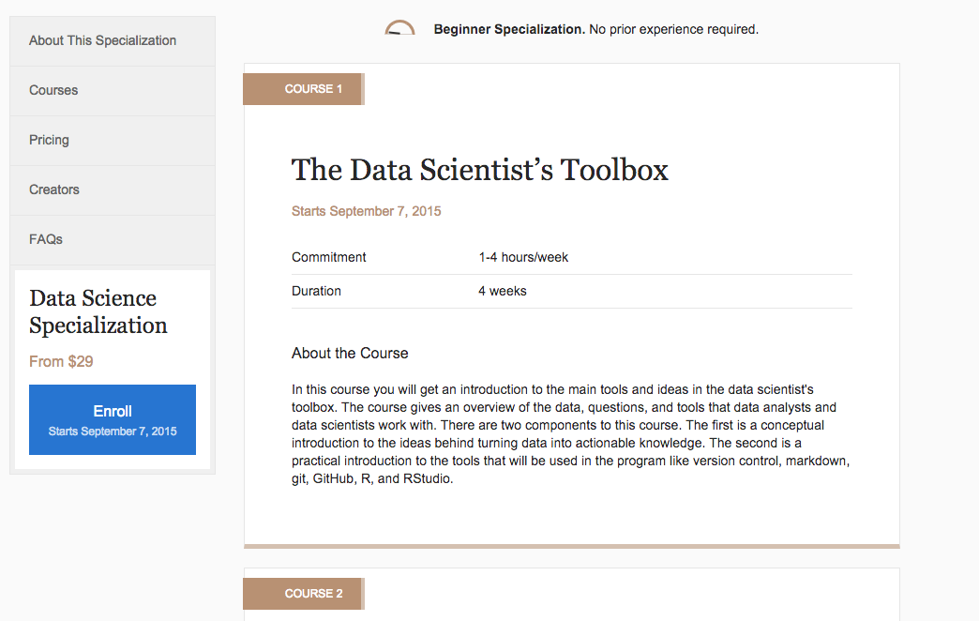
https://www.coursera.org/specializations/jhudatascience

